Slide 1
Module 2 Know Your Data
‹#›
Notes:
‹#›
‹#›

Slide 2
Getting to Know Your Data
Data Objects and Attribute Types
Basic Statistical Descriptions of Data
Measuring Data Similarity and Dissimilarity
‹#›
Notes:
‹#›
‹#›

Slide 3
Data Objects
Data sets are made up of data objects.
A data object represents an entity.
Examples:
sales database: customers, store items, sales
medical database: patients, treatments
university database: students, professors, courses
Also called samples , examples, instances, data points, objects, tuples.
Data objects are described by attributes.
Database rows -> data objects; columns ->attributes.
‹#›
Notes:
‹#›
‹#›

Slide 4
Attributes
Attribute (or dimensions, features, variables):
A data field, representing a characteristic or feature of a data object.
e.g., customer _ID, name, address
Observations: observed values for a given attribute
Attribute vector/feature vector: A set of attributes that define an object.
univariate.vs Bivariate Distribution vs Multivariate
Types:
Nominal
Ordinal
Interval-scaled
Ratio-scaled
‹#›
Notes:
‹#›
‹#›

Slide 5
Attribute Types – Categorical/Qualitative
Nominal: categories, states, or “names of things”
Hair_color = {auburn, black, blond, brown, grey, red, white}
marital status, occupation, ID numbers, zip codes
In the cases of nominal attributes with numeric values e.g. Cust_ID, the numbers are not intended to be used quantitatively.
Also in case of numeric nominal attributes , values do not have any meaningful order about them.
‹#›
Notes:
‹#›
‹#›

Slide 6
Attribute Types – Categorical/Qualitative
2. Binary attributes
Nominal attribute with only 2 categories/states (0 or 1)
0: attribute is absent
1: attribute is present
Symmetric binary: both outcomes equally important
e.g., gender
Asymmetric binary: outcomes not equally important.
e.g., medical test (positive vs. negative)
Convention: assign 1 to most important outcome (e.g., HIV positive)
If two states are True and False ,then called as Boolean Attribute
‹#›
Notes:
‹#›
‹#›

Slide 7
Attribute Types – Categorical/Qualitative
3. Ordinal Attributes:
Values have a meaningful order or a ranking among them but magnitude between successive values is not known.
Ex: Size = {small, medium, large}, grades, professor rankings
Useful for registering subjective assessments of qualities that cannot be measured objectively; thus often used in surveys for ratings.
E.g Customer satisfaction survey
We can compute mean and median but not mode for the ordinal attributes .
Note:nominal, binary, and ordinal attributes are qualitative attributes.
‹#›
Notes:
‹#›
‹#›

Slide 8
Numeric/Quantitative Attribute
4. Numeric Attributes /Quantitative Attributes
Represents measurable quantity in integer or real values
4.1 Interval scaled attributes
Measured on a scale of equal-sized units
Values have order and can be positive, 0, or negative
E.g., temperature in C˚or F˚, calendar dates
We can obtain a ranking of objects by ordering the values.
Also allow us to compare and quantify the difference between values.
No true zero-point -We can not speak of values in terms of ratio.
e.g without a true zero point, we can’t say that 10 C˚ is twice as warm as 5C˚.
Mean ,Median and Mode
‹#›
Notes:
‹#›
‹#›

Slide 9
Numeric Attribute Types
4.2 Ratio scaled attributes
Inherent zero-point
The values are ordered, and we can also compute the difference between values, as well as the mean, median,and mode
Examples: Count attributes such as years of experience and number of words attribute for a document
attributes to measure age, weight, height and monetary quantities (e.g., you are 100 times richer with $100 than with $1).
‹#›
Notes:
‹#›
‹#›

Slide 10
Discrete vs. Continuous Attributes
Discrete Attribute
Has only a finite or countably infinite set of values which may or may not be represented as integers.
E.g., zip codes, profession, or the set of words in a collection of documents
Sometimes, represented as integer variables
Note: Binary attributes are a special case of discrete attributes
‹#›
Notes:
‹#›
‹#›

Slide 11
Discrete vs. Continuous Attributes
Continuous Attribute
Has real numbers as attribute values
E.g., temperature, height, or weight
Practically, real values can only be measured and represented using a finite number of digits
Continuous attributes are typically represented as floating-point variables
‹#›
Notes:
‹#›
‹#›

Slide 12
Basic Statistical Descriptions of Data
Used to identify properties and identify which data values can be treated as noise or outliers.
3 areas of statistical descriptions:
Measuring central tendencies
Measuring dispersion of data(How data spread out?)
Graphic display of basic statistical description
‹#›
Notes:
‹#›
‹#›

Slide 13
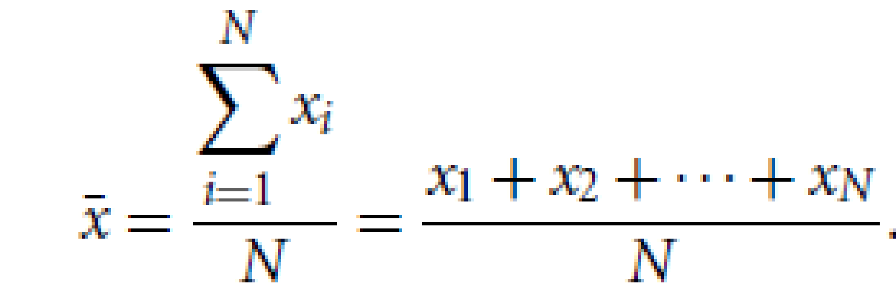
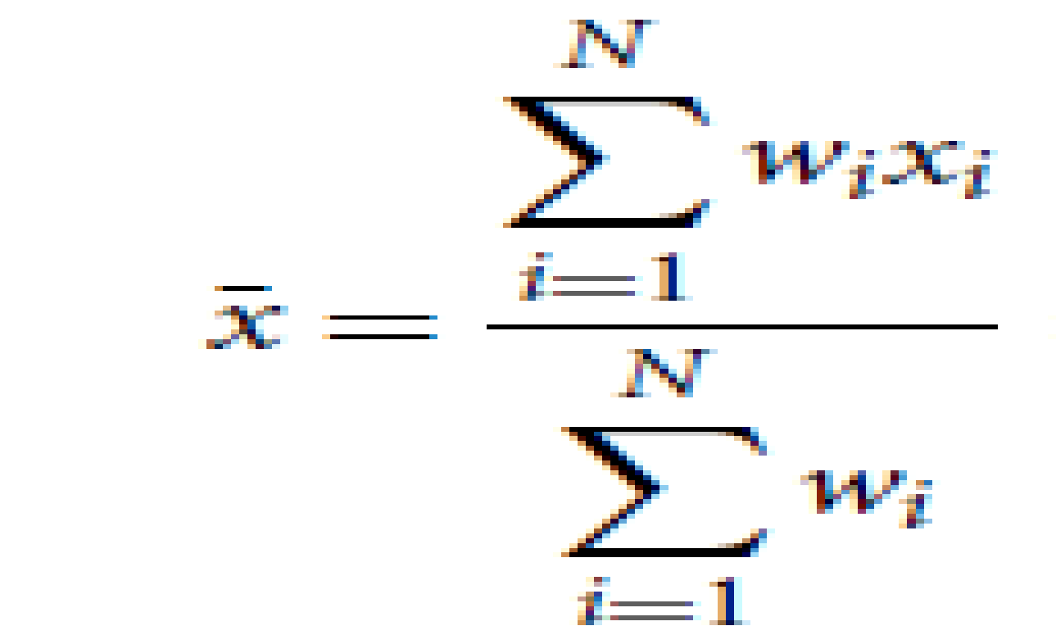
Measuring the Central Tendency:Mean
Mean (algebraic measure) (sample vs. population):
If we were to plot the observations for attribute, where would most of the values fall?
The most common and effective numeric measure of the “center” of a set of data is the (arithmetic) mean.
Let x₁, x₂, x₃, x₄, ….. x_{N} be a set of N values or observations, such as for some numeric attribute X, like salary.
The mean of this set of values is
Weighted mean is :
Problem with mean is its sensitivity to extreme values.
For skewed (asymmetric) data, a better measure of the center of data is the median
‹#›
Notes:
‹#›
‹#›

Slide 14
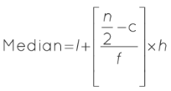
Measuring the Central Tendency:Median
Median:
Middle value if odd number of values, or average of the middle two values otherwise
The median is expensive to compute when we have a large number of observations.
Estimated by interpolation (for grouped data):
l = lower limit of median class
n = total number of observations
c = cumulative frequency of the preceding class
f = frequency of each class
h = class size
‹#›
Notes:
‹#›
‹#›

Slide 15
Marks | Number of students | Cumulative frequency
0 - 20 | 6 | 0 + 6 | 6
20 - 40 | 20 | 6 + 20 | 26
40 - 60 | 37 | 26 + 37 | 63
60 - 80 | 10 | 63 + 10 | 73
80 - 100 | 7 | 73 + 7 | 80
Solution:
We need to calculate the cumulative frequencies to find the median.
N = sum of f = 80, N/2 = 80/2 = 40
Since n is even, we will find the average of the n/2th and the (n/2 +1)^{th} observation i.e. the cumulative frequency greater than 40 is 63 and the class is 40 - 60. Hence, the median class is 40 - 60.
l = 40, f = 37, c = 26, h = 20
Median = l + [(n/2−c)/f] × h == 40 + [(37 - 26)/40] × 20 == 40 + (11/40) × 20 = = 40 + (220/40) = 40 + 5.5 == 45.5

Slide 16
Measuring the Central Tendency:Mode and midrange
Mode
Value that occurs most frequently in the data
Unimodal, bimodal, trimodal,multimodal
At the other extreme, if each data value occurs only once, then there is no mode.
Midrange
The midrange can also be used to assess the central tendency of a numeric data set.
It is the average of the largest and smallest values in the set.
‹#›
Notes:
‹#›
‹#›

Slide 17
Measuring the Central Tendency: Example
Suppose we have the following values for salary (in thousands of dollars), shown
in increasing order: 30, 36, 47, 50, 52, 52, 56, 60, 63, 70, 70, 110.
Claculate mean, median,mode and midrange
Mean=58
Median=54
Modes = bimodal. The two modes are 52 and 70
Midrange=70 Mean=
‹#›
Notes:
‹#›
‹#›

Slide 18
Measuring the Dispersion of Data
(Range, Quartiles, Variance ,Standard Deviation, and Interquartile Range)
Range, Quartiles, and Interquartile Range
The range of the data set is the difference between the largest (max()) and smallest (min()) values.
Quantiles are points taken at regular intervals of a data distribution, dividing it into essentially equal size consecutive sets.
The kth q-quantile for a given data distribution is the value x such that at most k/q of the data values are less than x and at the most (q-k)/q of the data values are more than x, where k is an integer such that 0 < k < q. There are q-1 q-quantiles.
The 2-quantile is the data point dividing the lower and upper halves of the data distribution.It corresponds to the median
The 4-quantiles are the three data points that split the data distribution into four equal parts; each part represents one-fourth of the data distribution. They are more commonly referred to as quartiles
The 100-quantiles are more commonly referred to as percentiles; they divide the data distribution into 100 equal-sized consecutive sets.
The median, quartiles, and percentiles are the most widely used forms of quantiles.
‹#›
Notes:
‹#›
‹#›

Slide 19
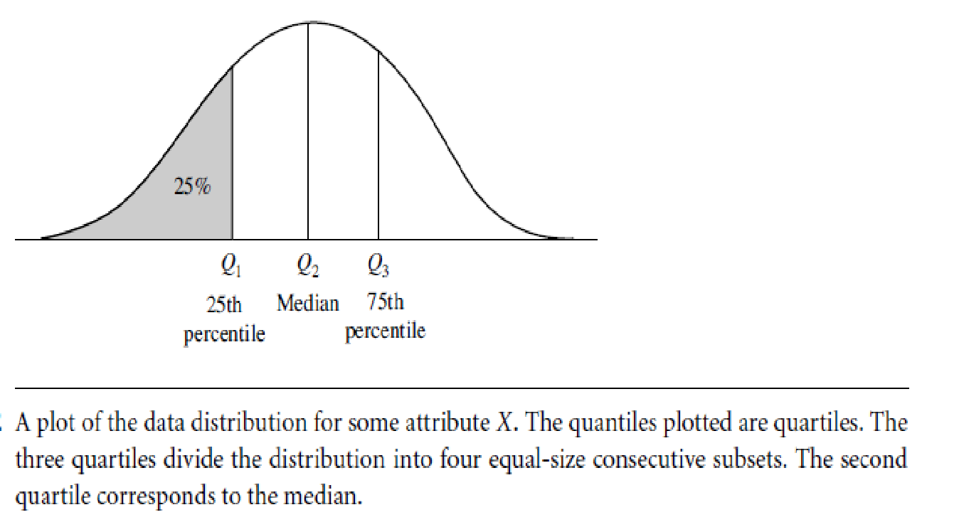
Quartiles:The quartiles are the three values that split the sorted data set into
four equal parts
The quartiles give an indication of a distribution’s center, spread, and shape
Q1, is the 25th percentile
Q3, is the 75th percentile
The second quartile Q2 is, the 50th percentile. As the median, it gives the center of the data distribution.
InterQuartile Range (IQR) :The distance between the first and third quartiles is a simple measure of spread that gives the range covered by the middle half of the data.
IQR = Q3 -Q1.
Ex: 30, 36, 47, 50, 52, 52, 56, 60, 63, 70, 70, 110
the quartiles for this data are the third, sixth, and ninth values respectively, in the sorted list Therefore, Q1 =47 and Q3 =63. Thus, the IQR=63-47 =16

Slide 20
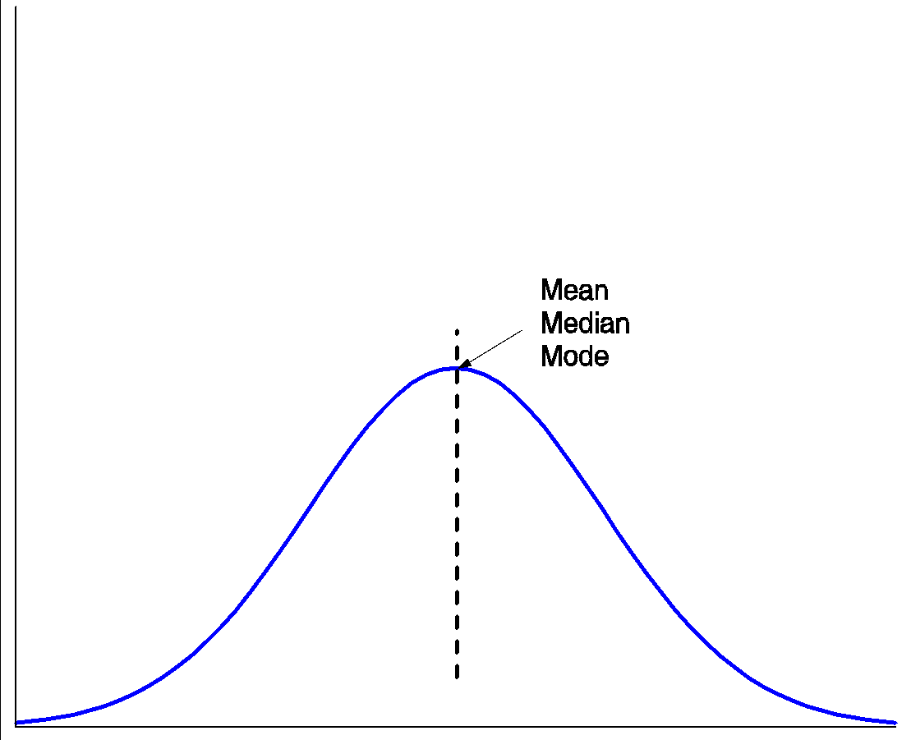
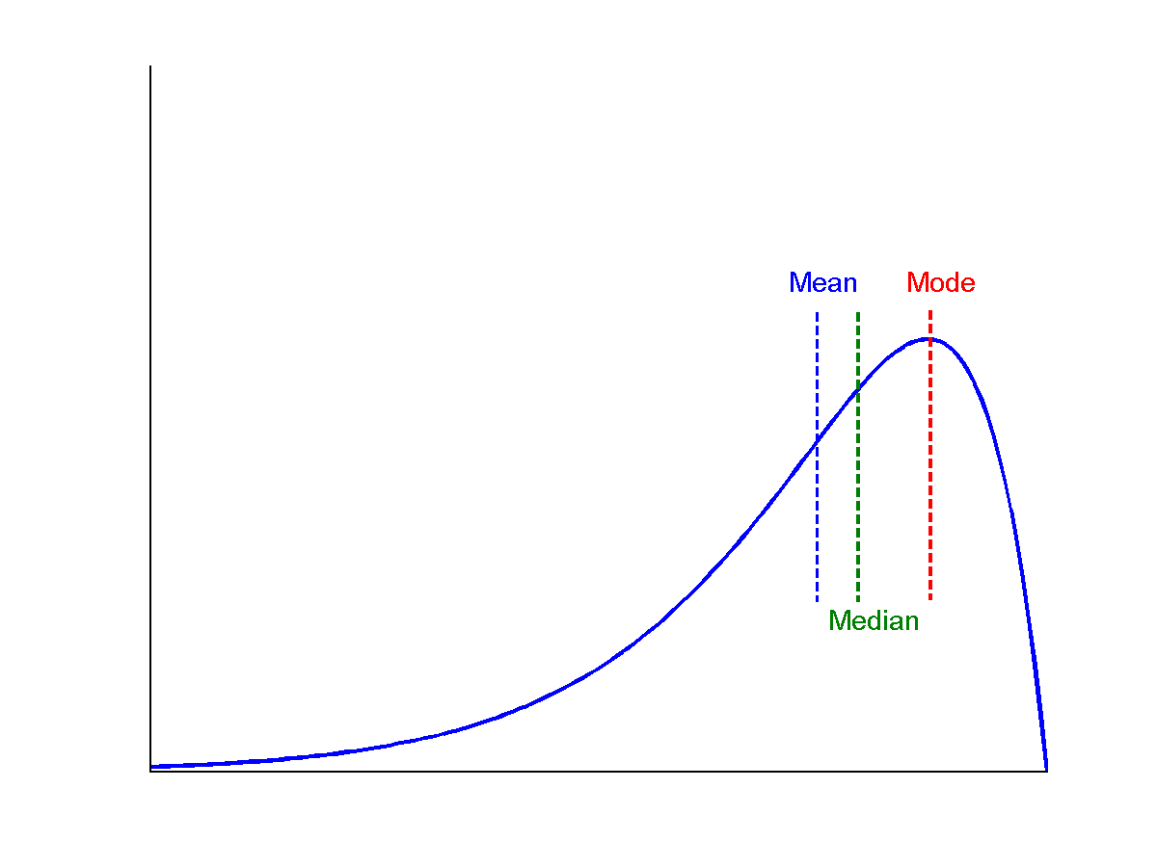
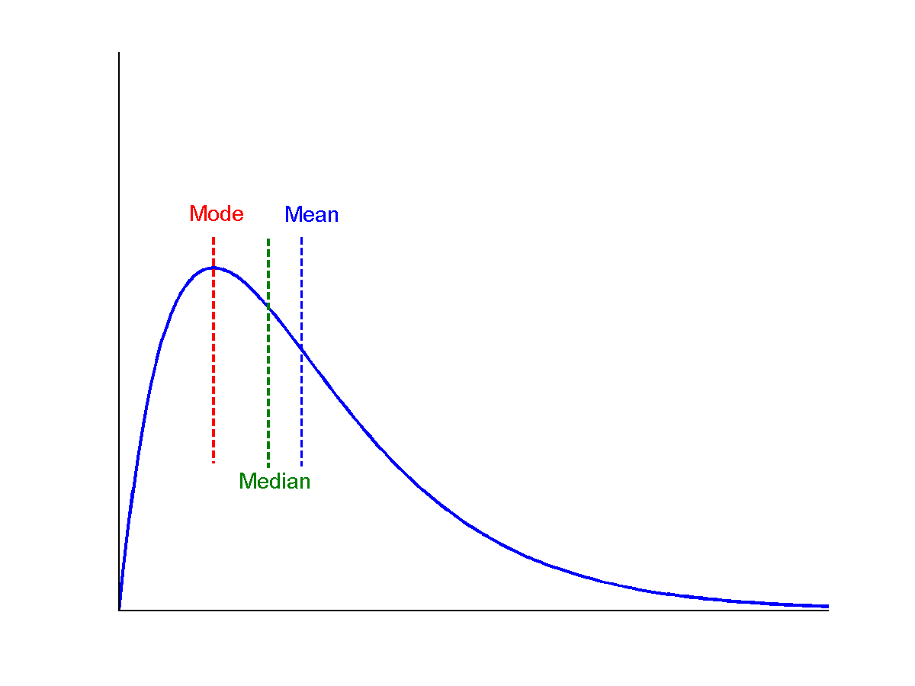
Median, mean and mode of symmetric, positively and negatively skewed data
In the symmetric distribution, the median (and other measures of central tendency) splits the data into equal-size halves.
symmetric
positively skewed
negatively skewed
*
Data Mining: Concepts and Techniques
‹#›
Notes:
‹#›
‹#›

Slide 21
Five Number Summary
Five-number summary of a distribution (Minimum, Q1, Median, Q3, Maximum)
It is more informative to also provide the two quartiles Q1 and Q3, along
with the median
A common rule of thumb for identifying suspected outliers is to single out values falling at least 1.5IQR above the third quartile or below the first quartile.
Because Q1, the median, and Q3 together contain no information about the endpoints (e.g., tails) of the data, a fuller summary of the shape of a distribution can be obtained by providing the lowest and highest data values as well. This is known as the five-number summary.
The five-number summary of a distribution consists of the median (Q2), the quartiles Q1 and Q3, and the smallest and largest individual observations, written in the order of Minimum, Q1, Median, Q3, Maximum.
‹#›
Notes:
‹#›
‹#›

Slide 22
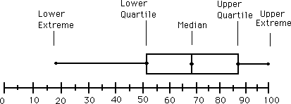
Boxplot Analysis
Boxplots are a popular way of visualizing a distribution.
A boxplot incorporates the five-number summary as follows:
Typically, the ends of the box are at the quartiles so that the box length is the interquartile range.
The median is marked by a line within the box.
Two lines (called whiskers) outside the box extend to the smallest (Minimum) and largest (Maximum) observations.
When dealing with a moderate number of observations, it is worthwhile to plot potential outliers individually. To do this in a box plot, the whiskers are extended to the extreme low and high observations only if these values are less than 1.5IQR beyond the quartiles. Otherwise, the whiskers terminate at the most extreme observations occurring within 1.5IQR of the quartiles. The remaining cases are plotted individually.
‹#›
Notes:
‹#›
‹#›

Slide 23
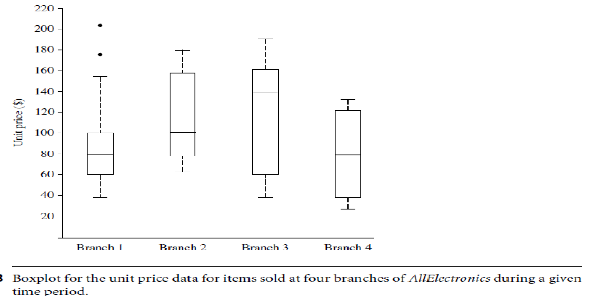
Boxplot Analysis: Example
In this boxplot :
For branch 1, we see that the median price of items sold is $80, Q1 is $60, and Q3 is $100.
Notice that two outlying observations for this branch were plotted individually, as their values of 175 and 202 are more than 1.5 times the IQR here of 40.
‹#›
Notes:
‹#›
‹#›

Slide 24

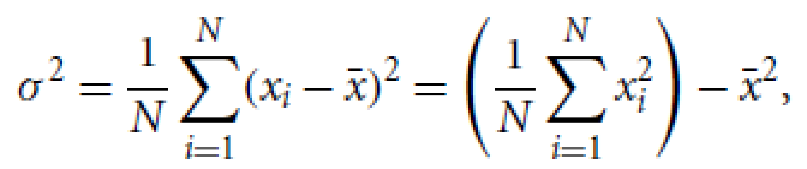
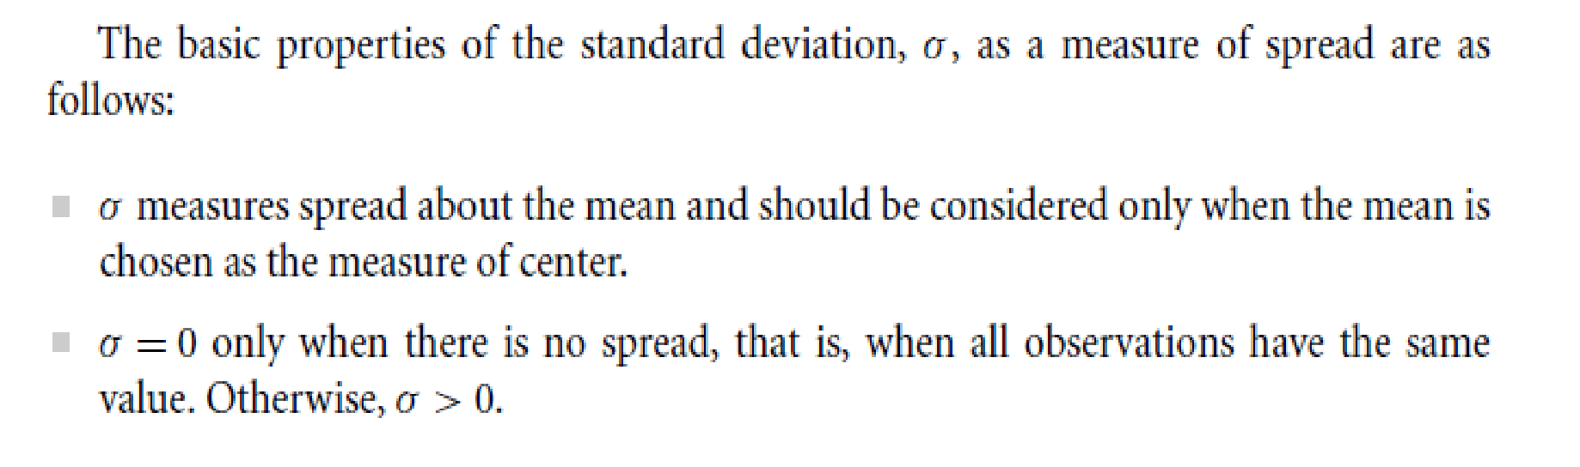
Variance and Standard Deviation
They indicate how spread out a data distribution is.
The standard deviation, , of the observations is the square root of the variance,
A low standard deviation means that the data observations tend to be very close to the mean, while a high standard deviation indicates that the data are spread out over a large range of values.
The variance of N observations, x1,x2, : : : ,xN, for a numeric attribute X is
‹#›
Notes:
‹#›
‹#›

Slide 25
Measuring the Central Tendency
Suppose we have the following values for salary (in thousands of dollars), shown
in increasing order: 30, 36, 47, 50, 52, 52, 56, 60, 63, 70, 70, 110.
Claculate variance and standard deviation.
Mean=58
Median=54
Modes = bimodal. The two modes are 52 and 70
Midrange=70 Mean=
Variance= 379.17
Std. Deviation= 19.47
‹#›
Notes:
‹#›
‹#›

Slide 26
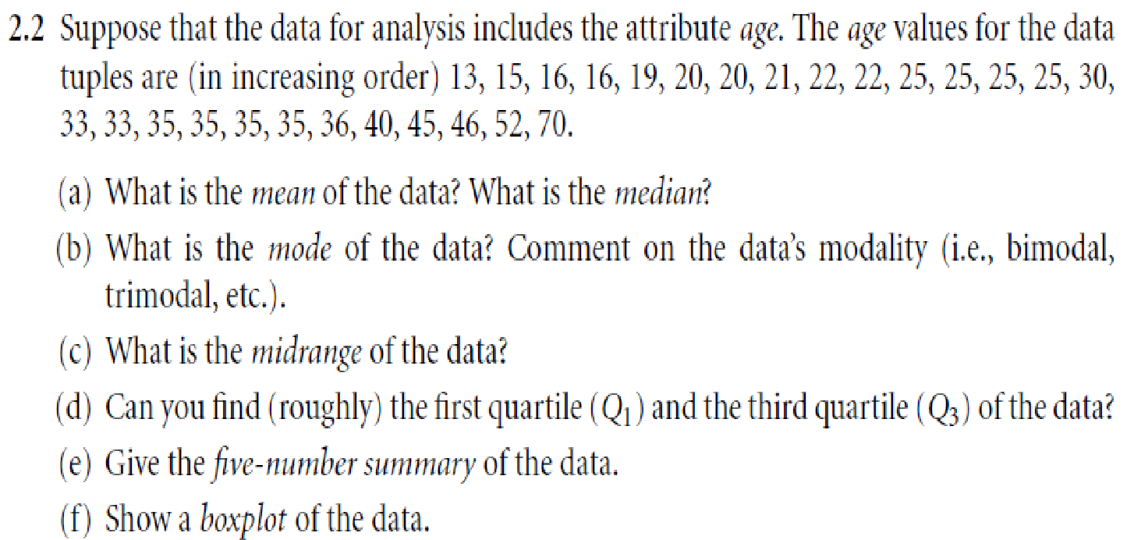
Problems
30,25
25,35, Bimodal
41.5
20,35
13,20,25,35,70
‹#›
Notes:
‹#›

Slide 27
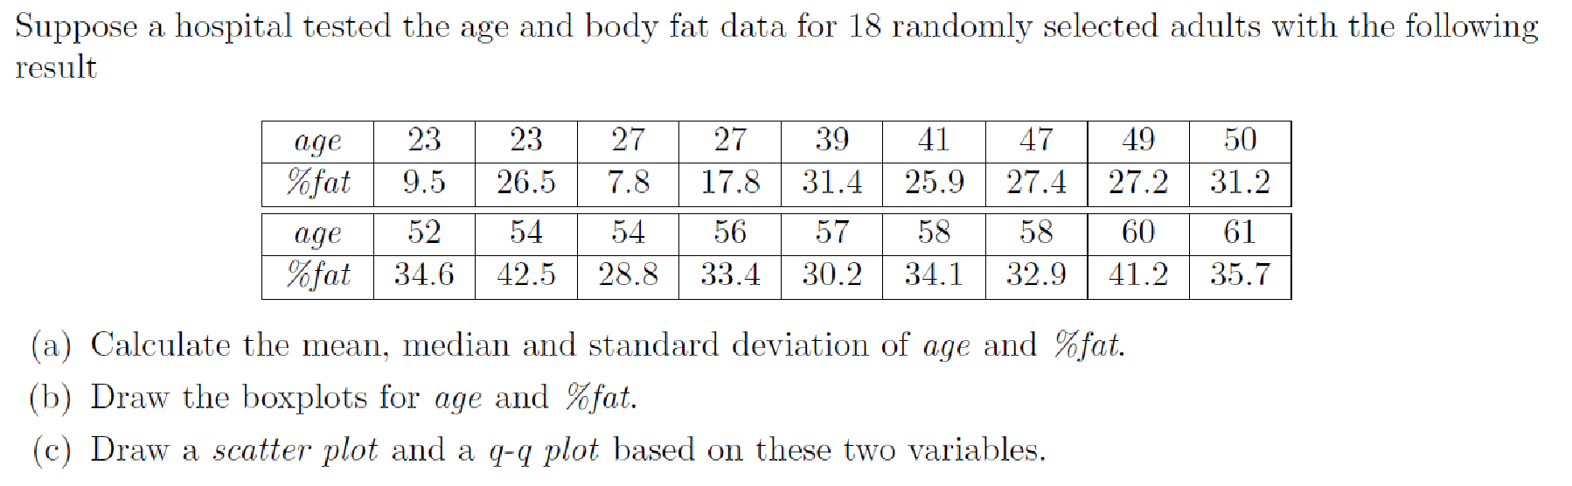

Slide 28
Measuring Data Similarity and Dissimilarity

Slide 29
Proximity(Similarity and Dissimilarity)
Similarity
Numerical measure of how alike two data objects are.
Value is higher when objects are more alike
Often falls in the range [0,1]
Dissimilarity (e.g., distance)
Numerical measure of how different two data objects are.
Lower when objects are more alike.
Minimum dissimilarity is often 0.
Upper limit varies
‹#›
Notes:
‹#›
‹#›

Slide 30
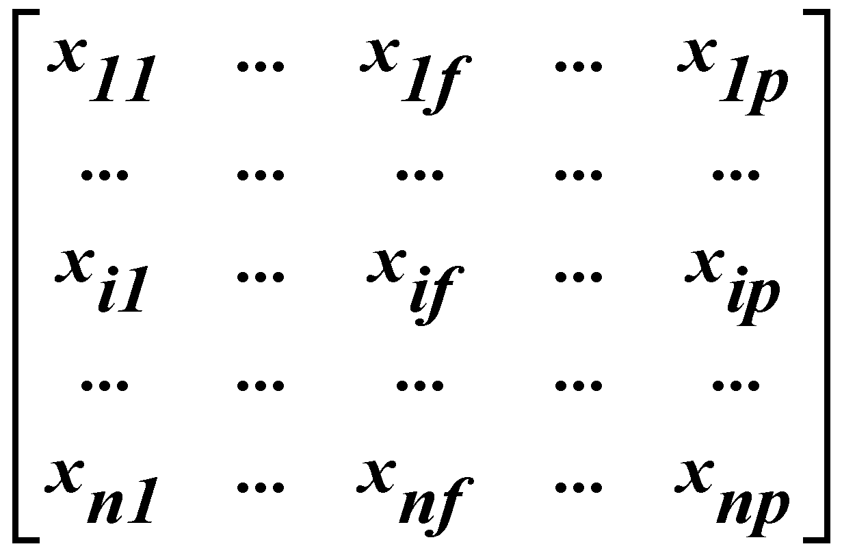
Data Matrix and Dissimilarity Matrix
Data matrix n-by-p matrix (n objects p attributes) : 2 mode matrix.
‹#›
Notes:
‹#›
‹#›

Slide 31
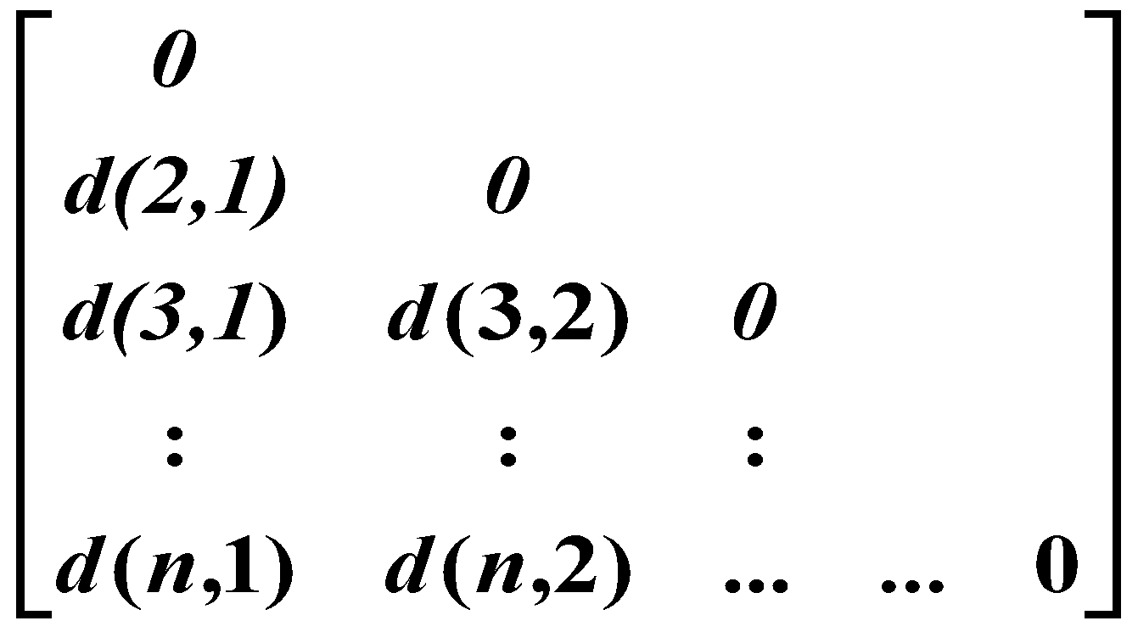
Data Matrix and Dissimilarity Matrix
Dissimilarity matrix : n X n Matrix
In general, d(i, j) is a non-negative number that is close to 0 when objects i and j are highly similar or “near” each other, and becomes larger the more they differ.
Note that d(i, i)= 0; i.e. the difference between an object and itself is 0. Furthermore, d(i, j) = d(j, i)
Measures of similarity can often be expressed as a function of measures of dissimilarity. For example, for nominal data, sim(i, j) = 1 – d(i, j) where sim(i, j) is the similarity between objects i and j.
Also called as one-mode matrix
‹#›
Notes:
‹#›
‹#›

Slide 32
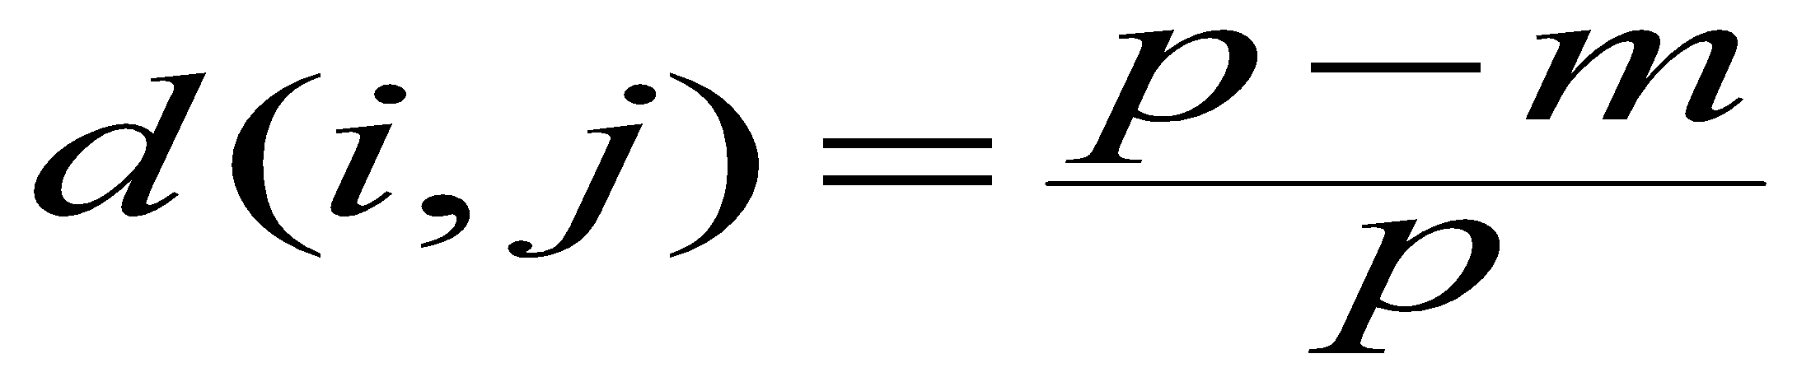
Proximity Measure for Nominal Attributes
A nominal attribute Can take 2 or more states,
“How is dissimilarity computed between objects described by nominal attributes?”
Method 1: Simple matching :The dissimilarity between two objects i and j can be computed based on the ratio of mismatches:
Where
p is the total number of attributes describing the objects.
m is the number of matches (i.e., the number of attributes for which i and j are in the same state)
‹#›
Notes:
‹#›
‹#›

Slide 33
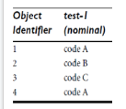
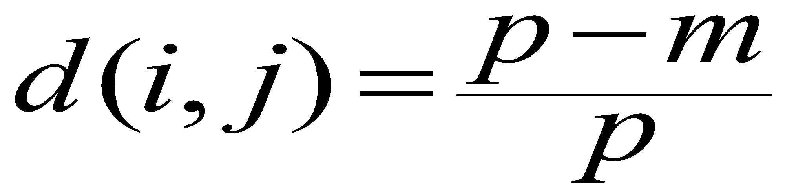
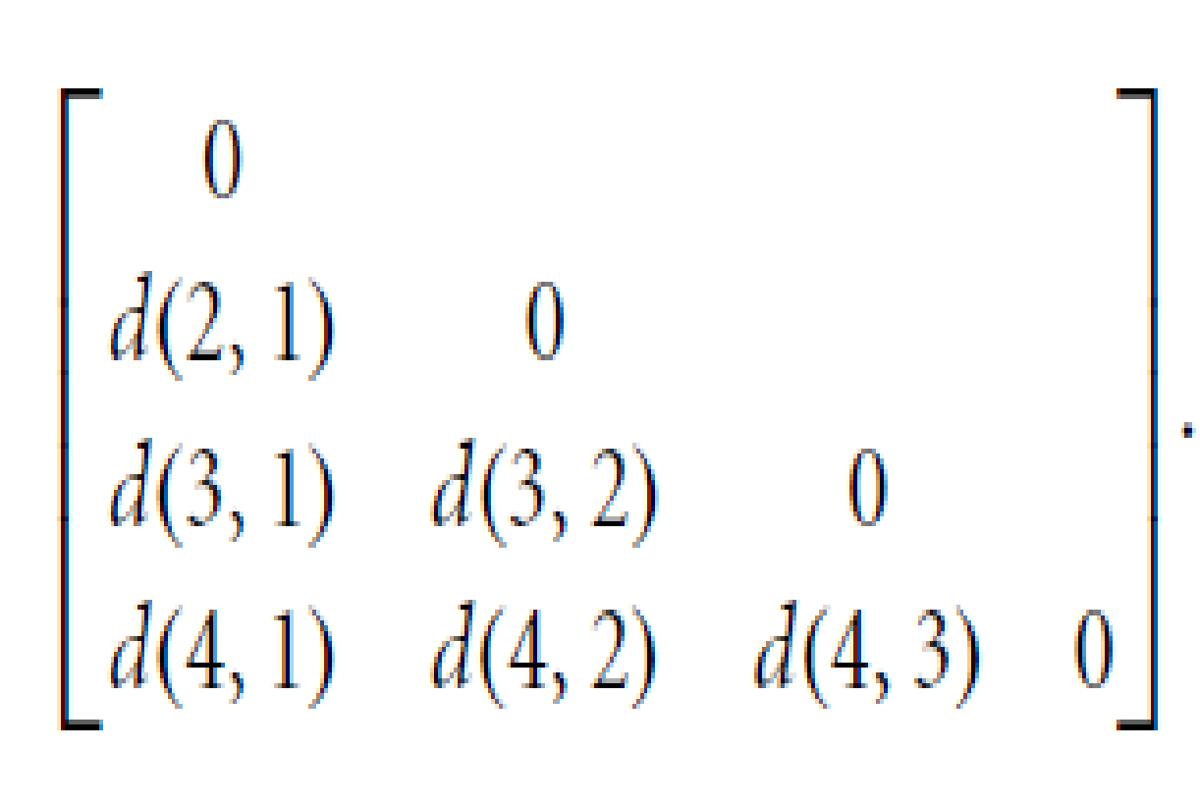
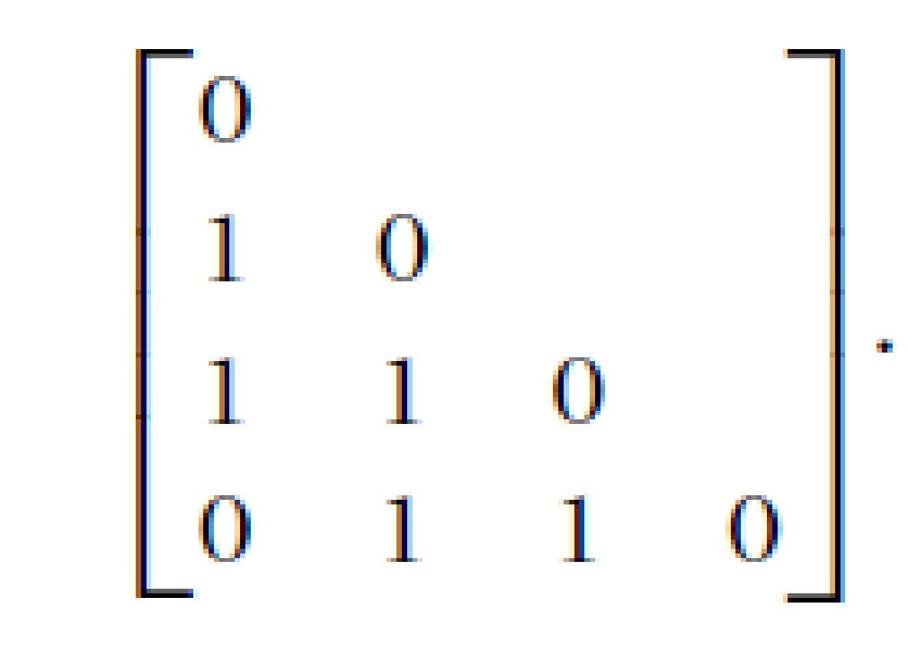
Proximity Measure for Nominal Attributes Example : Dissimilarity between nominal attributes.
Here p= 1
d(i, j) evaluates to 0 if objects i and j match, and 1 if the objects differ.
From this, we see that all objects are dissimilar except objects 1 and 4 (i.e.,d(4,1)= 0.
‹#›
Notes:
‹#›
‹#›

Slide 34
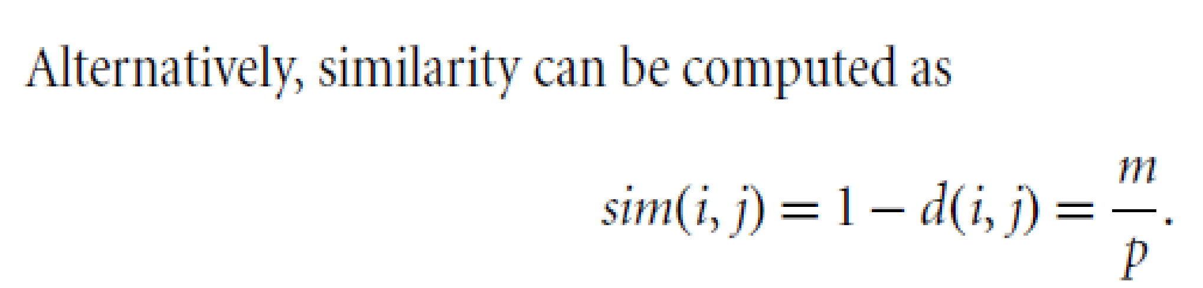
Proximity Measure for Nominal Attributes Example : Dissimilarity between nominal attributes.
Method 2: Use a large number of binary attributes
creating a new binary attribute for each of the M nominal states
‹#›
Notes:
‹#›
‹#›

Slide 35
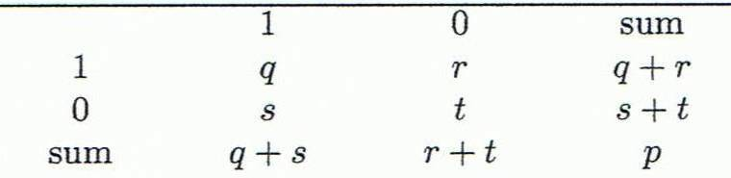
how can we compute the dissimilarity between two binary attributes?
One approach involves computing a dissimilarity matrix from the given binary data. If all binary attributes are thought of as having the same weight, we have the 2 x 2 contingency table as shown below
Where q = the number of attributes that equal 1 for both objects i and j,
r = the number of attributes that equal 1 for object i but equal 0 for object j,
s = the number of attributes that equal 0 for object i but equal 1 for object j,
t = the number of attributes that equal 0 for both objects i and j.
p = The total number of attributes = q + r + s + t .
Object j
Object i
‹#›
Notes:
‹#›
‹#›

Slide 36
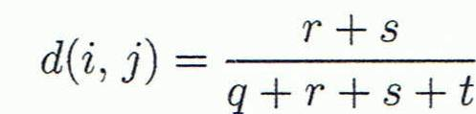
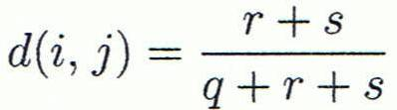

Proximity Measure for Binary Attributes
Object j
A contingency table for binary data
Distance measure for symmetric binary variables:
Distance measure for asymmetric binary variables:
Jaccard coefficient (similarity measure for asymmetric binary variables):
Object i
= 1- d(i,j)
‹#›
Notes:
‹#›
‹#›

Slide 37
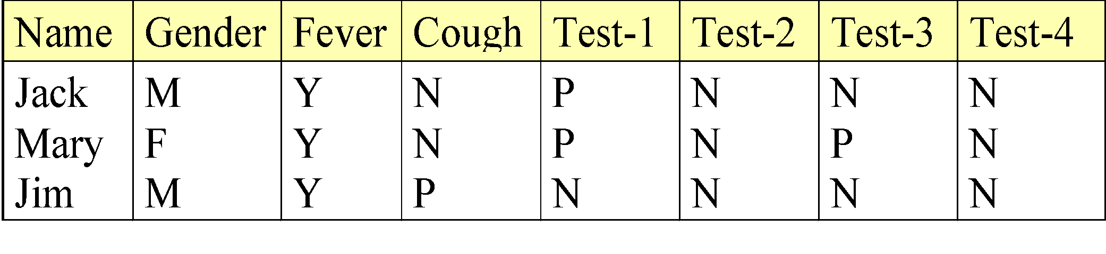
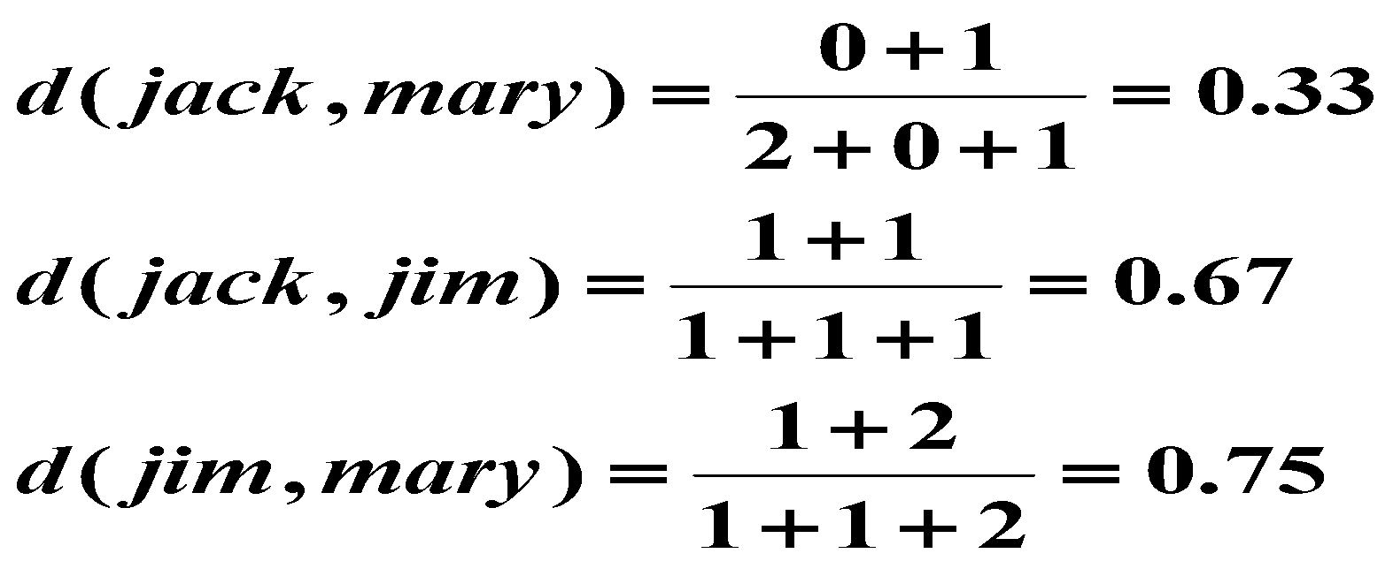
Dissimilarity between Binary Attributes
Example
Gender is a symmetric attribute
The remaining attributes are asymmetric binary
Let the values Y and P be 1, and the value N be 0
Suppose distance is computed based on only asymmetric attributes
These measurements suggest that Jim and Mary are unlikely to have a similar disease because they have the highest dissimilarity value among the three pairs.
Of the three patients, Jack and Mary are most likely to have a similar disease.
‹#›
Notes:
‹#›
‹#›

Slide 38
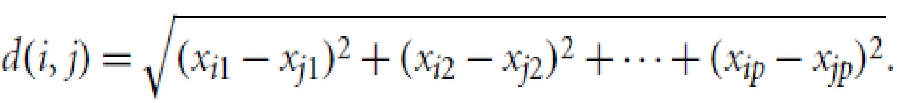
Dissimilarity of Numeric Data:
Euclidean distance: The most popular distance measure
where i = (x_{i1}, x_{i2}, …, x_{ip}) and j = (x_{j1}, x_{j2}, …, x_{jp}) are two objects described by numeric attributes.
Manhattan (or city block) distance: named so because it is the distance in blocks between any two points in a city (such as 2 blocks down and 3 blocks over for a total of 5 blocks).
The distance between two points measured along axes at right angles
‹#›
Notes:
‹#›
‹#›

Slide 39
Dissimilarity of Numeric Data:
Minkowski Distance
The Euclidean and the Manhattan distance satisfy the following mathematical properties:
Non-negativity: d(i, j) >= 0: Distance is a non-negative number.
Identity of indiscernibles: d(i, j) = 0:The distance of an object to itself is 0.
Symmetry: d(i, j) = d(j, i) : Distance is a symmetric function.
Triangle inequality: d(i, j) <=d(i, k)+d(k,j): Going directly from object i to object j in space is no more than making a detour over any other object k.
A measure that satisfies these conditions is known as metric.
‹#›
Notes:
‹#›
‹#›

Slide 40
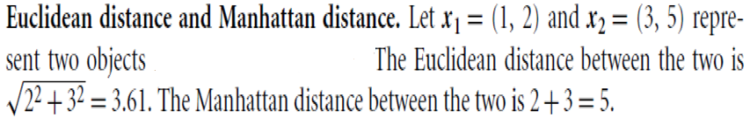
Example: Euclidean and Manhattan distance

Slide 41
Dissimilarity of Numeric Data:
Minkowski Distance
Minkowski distance: A generalization of Euclidean and Manhattan distances
where i = (x_{i1}, x_{i2}, …, x_{ip}) and j = (x_{j1}, x_{j2}, …, x_{jp}) are two objects described by p numeric attributes and h is a real number such that h >= 1.
Also called as L_{p} norm where p refers to h.
It represents the Manhattan distance when h = 1 (i.e., L1 norm) and Euclidean distance when h = 2 (i.e., L2 norm).
‹#›
Notes:
‹#›
‹#›

Slide 42
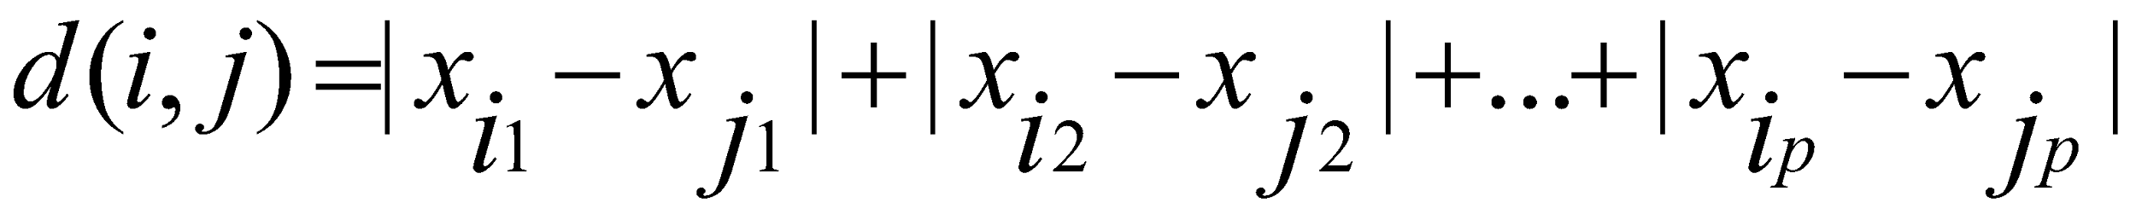
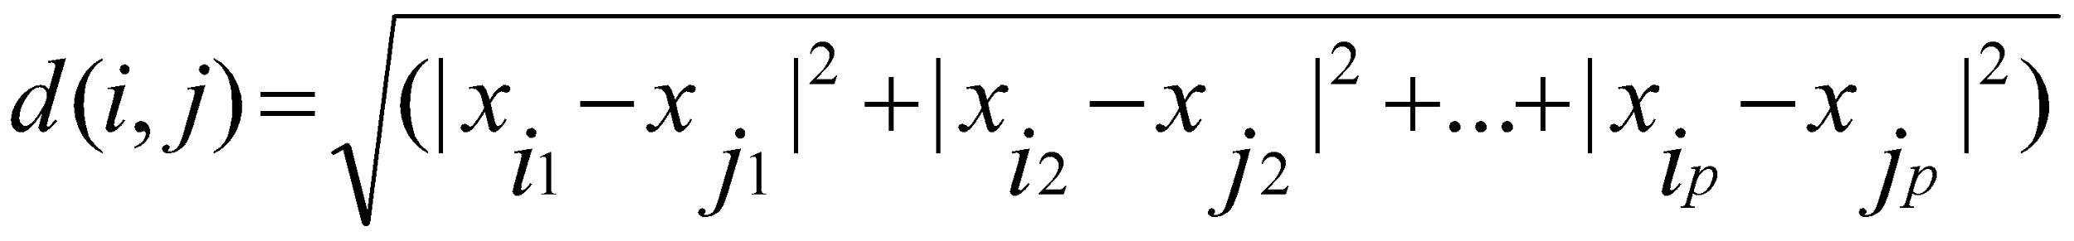
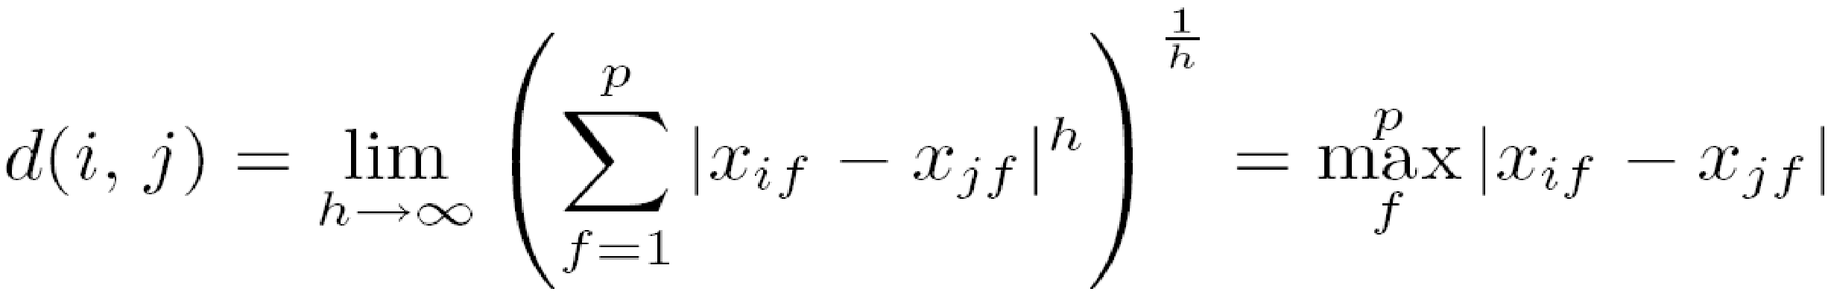

Special Cases of Minkowski Distance
h = 1: Manhattan (city block, L₁ norm) distance
h = 2: (L₂ norm) Euclidean distance
h → ∞. “supremum” (L_{max} norm, L∞ norm,Chebyshev distance) distance.
To compute it, we find the attribute f that gives the maximum difference in values between the two objects.
This difference is the supremum distance, defined more formally as:
Example:
‹#›
Notes:
‹#›
‹#›

Slide 43
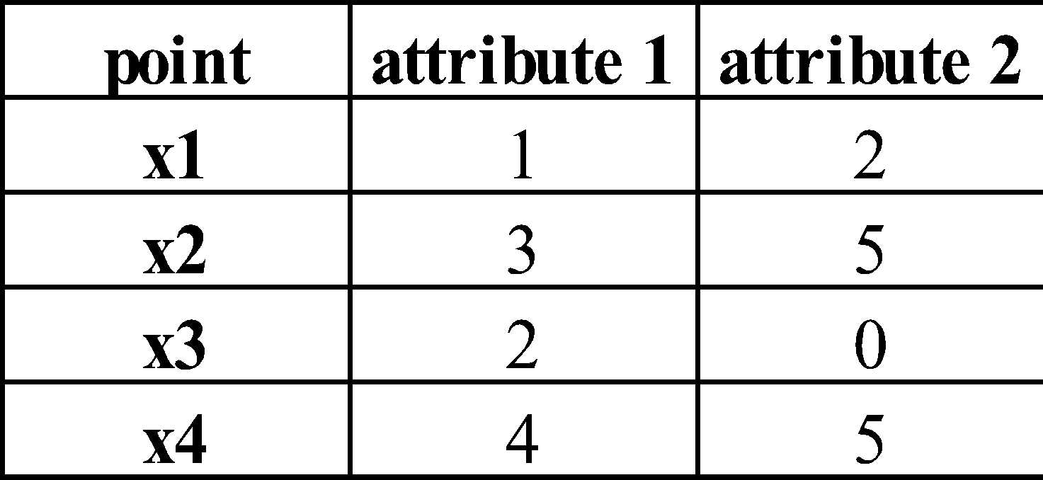
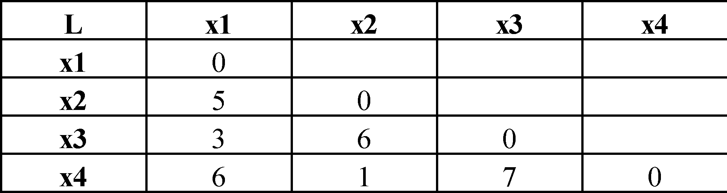
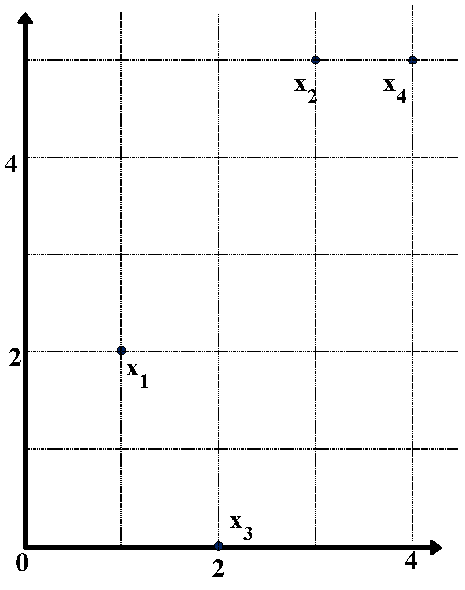
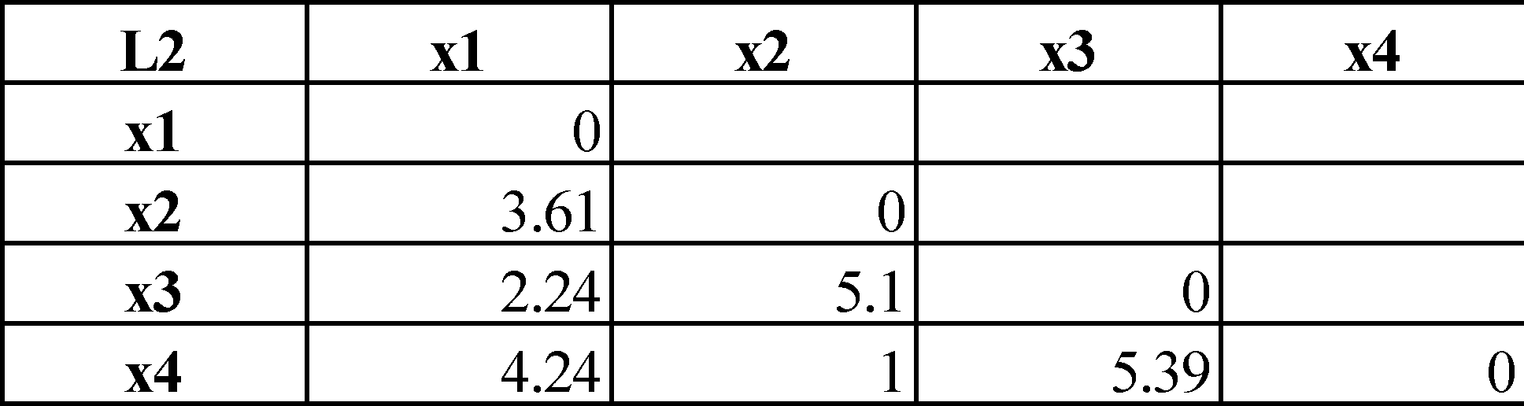
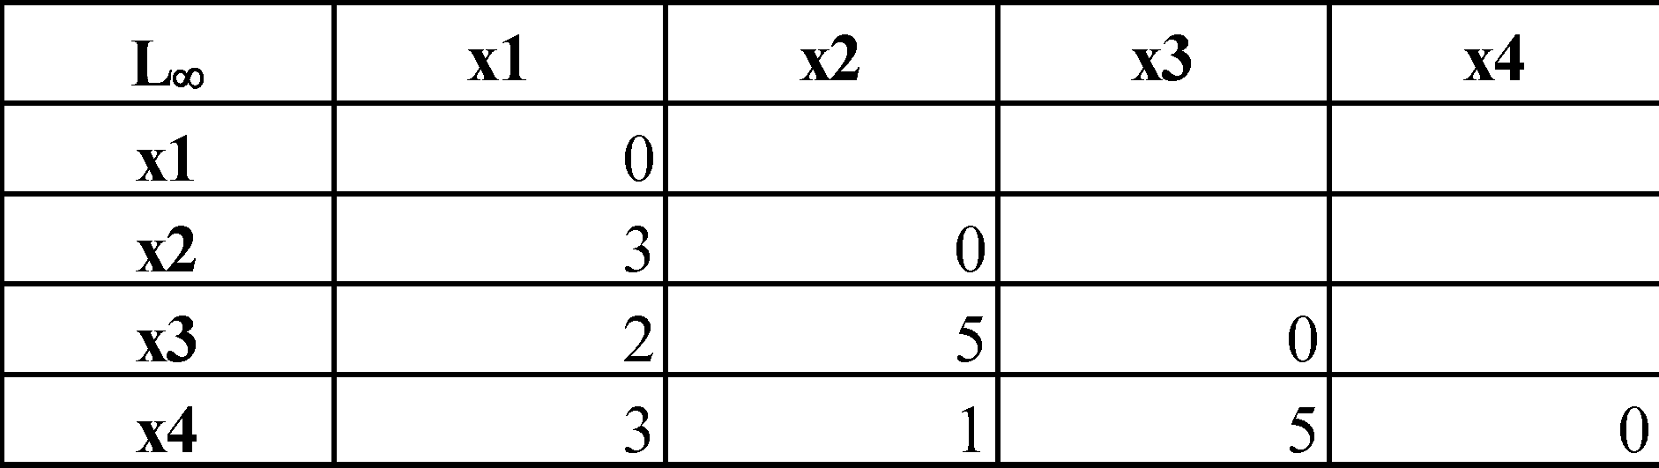
Example: Minkowski Distance
Dissimilarity Matrices
Manhattan (L₁)
Euclidean (L₂)
Supremum
‹#›
Notes:
‹#›
‹#›

Slide 44

Ordinal Variables
Suppose that f is an attribute from a set of ordinal attributes describing n objects.
The dissimilarity computation with respect to f involves the following 3 steps:
1. Let the value of f for the i-th object is xif , and f has Mf ordered states, representing the ranking: 1, 2, …. , Mf . Replace each xif by its corresponding rank, rif = {1,2 f1,.... , Mf }.
2. Map the range of each attribute onto [0.0, 1.0] so that each attribute has equal weight. Perform such data normalization by replacing the rank rif of the i-th object in the f th attribute by
3. Dissimilarity can then be computed using any of the distance measures for numeric attributes, using zif to represent the f value for the i-th object.
‹#›
Notes:
‹#›
‹#›

Slide 45
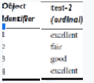
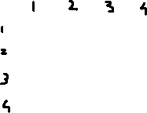
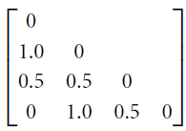
Example: Dissimilarity for Ordinal Variables
Step 1: There are three states for test-2: fair, good,
excellent, that is, Mf = 3.
m Replace each value for test-2 by its rank, So
objects 1 to 4 will be assigned ranks 3, 1, 2, and 3 resp 3sp.
Step 2: Normalize the ranking by mapping rank 1 to 0.0, rank 2 to 0.5, and rank 3 to 1.0.
Step 3: we can use, say, the Euclidean distance , which results in the following dissimilarity matrix:
Objects 1 and 2 are the most dissimilar, as are objects 2 and 4 (i.e., d(2,1)=1.0 and d(4,2)= 1.0).
sim(i, j)= 1 - d(i,,j ).
Notes:
‹#›

Slide 46
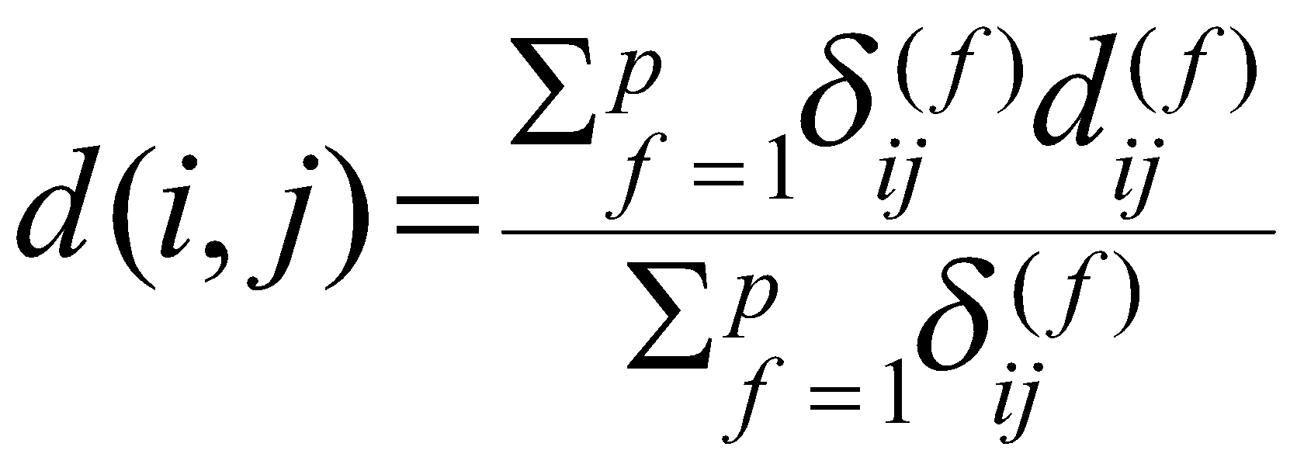
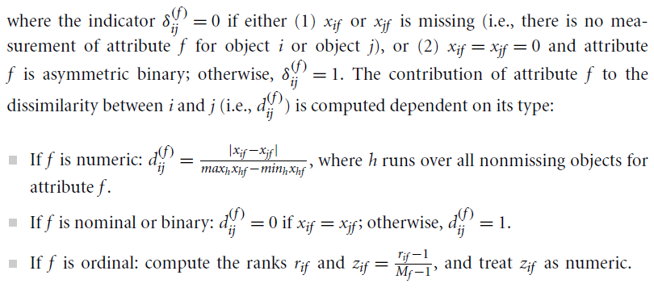
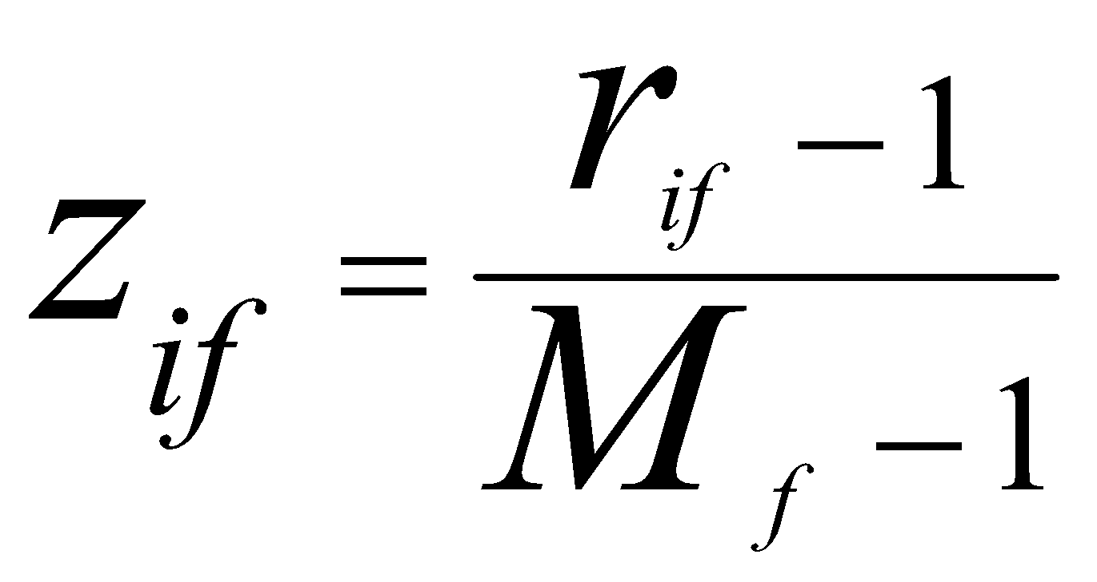
Attributes of Mixed Type
Suppose that the data set contains p attributes of mixed type. The dissimilarity d(i, j) between objects i and j is defined as
‹#›
Notes:
‹#›
‹#›

Slide 47

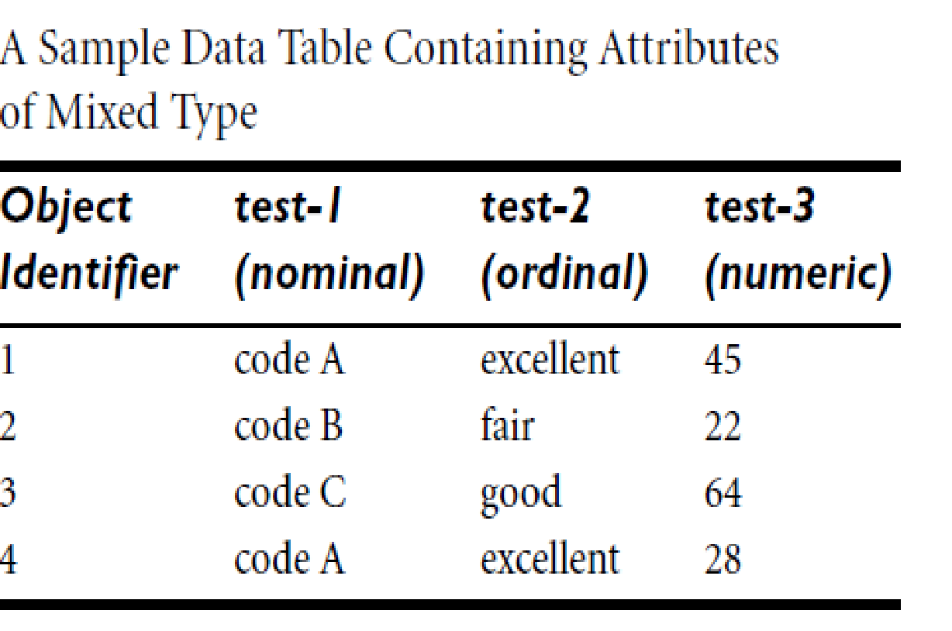
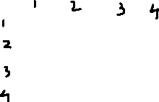
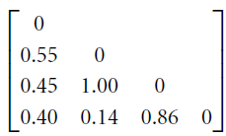
Example: Dissimilarity between attributes of mixed type
We have computed Dissimilarity matrix for test-1 (which is nominal) and test-2 (which is ordinal),
Let us compute the dissimilarity matrix for the third attribute, test-3 (which is numeric).That is, we must compute
Using the above case of numeric attributes, let maxhxh = 64 and minhxh = 22.
The difference between the two is used below to normalize the values of the dissimilarity matrix. The resulting dissimilarity matrix for test-3 is
Dissimilarity matrix for test-3 attribute
‹#›
Notes:
‹#›
‹#›

Slide 48
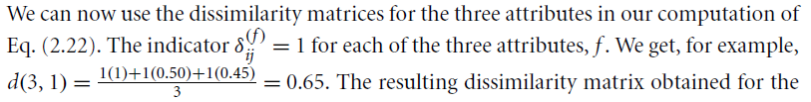
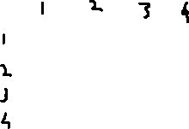
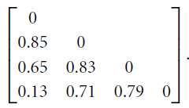
Test1 (Nominal)
Test2 (Ordinal)
Test3 (Numeric)
Notes:
‹#›

Slide 49
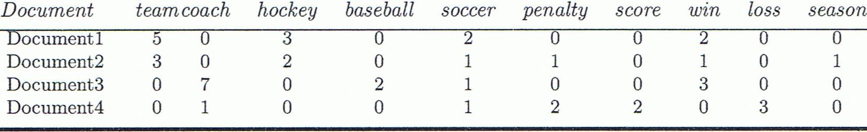
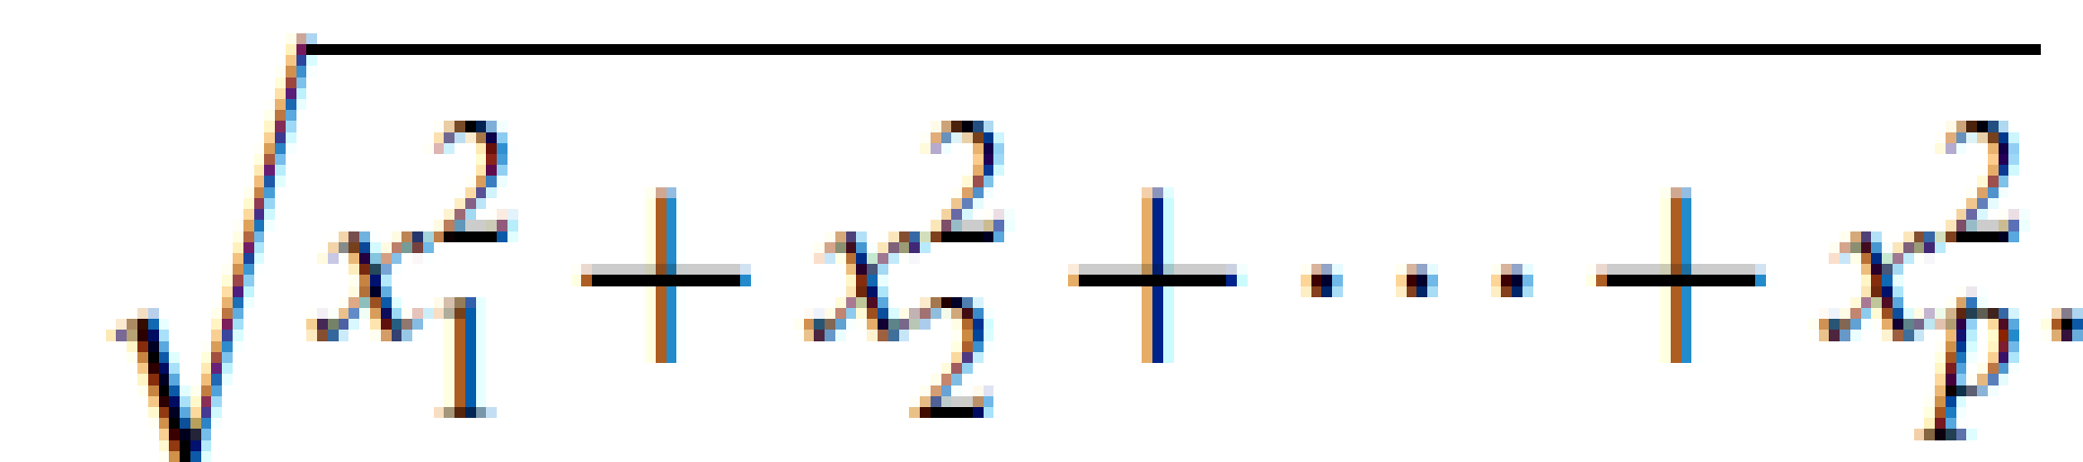
Cosine Similarity
A document can be represented by thousands of attributes, each recording the frequency of a particular word (such as keywords) or phrase in the document.
Applications: information retrieval, biologic taxonomy, gene feature mapping, ...
Cosine measure: If x and y are two vectors (e.g., term-frequency vectors), then
cos(x, y) = (x ∙ y) /||x|| ||y|| ,
where ∙ indicates vector dot product, ||x||: the Euclidean norm of vector x, defined as
= length of vector x
‹#›
Notes:
‹#›
‹#›

Slide 50
The Cosine measure computes the cosine of the angle between vectors x and y.
A cosine value of 0 means that the two vectors are at 90 degrees to each other (orthogonal) and have no match.
The closer the cosine value to 1, the smaller the angle and the greater the match between vectors.

Slide 51
Example: Cosine Similarity
cos(x, y ) = = (x ∙ y) / ||x|| ||y|| ,
where ∙ indicates vector dot product, ||d|: the length of vector d
Ex: Find the similarity between documents 1 and 2.
x = (5, 0, 3, 0, 2, 0, 0, 2, 0, 0)
y = (3, 0, 2, 0, 1, 1, 0, 1, 0, 1)
x∙y = 5*3+0*0+3*2+0*0+2*1+0*1+0*1+2*1+0*0+0*1 = 25
||x||= (5*5+0*0+3*3+0*0+2*2+0*0+0*0+2*2+0*0+0*0)^{0.5}=(42)^{0.5} = 6.481
||y||= (3*3+0*0+2*2+0*0+1*1+1*1+0*0+1*1+0*0+1*1)^{0.5}=(17)^{0.5} = 4.12
cos(x, y ) = 0.94 -----Quite similar
‹#›
Notes:
‹#›
‹#›

Slide 52

Problem 1

Slide 53

Solution-Problem 1

Slide 54

Problem 2

Slide 55

Solution –Problem2(a)

Slide 56

Solution-Problem 2(b)

